Slide 1


Developing High-Performing Teams
An interdisciplinary imperative for improvement
Andrea Branchaud, MPH Project Manager Health Care Quality | Tracy Lee, MSN, RN Nursing Director Inpatient Medicine | Daniel Ricotta, MD Chief Medical Resident | Lauge Sokol-Hessner, MD Assoc. Dir. Inpatient Quality Health Care Quality
The presenters have no relevant disclosures
Notes:
Reinvigorating? Redesigning? Rethinking?

Slide 2
The Problem
  Unstable inpatient → “trigger” (aka rapid response)
    2015: 5024 triggers at BIDMC, 71% on services covered by IM housestaff
    ~50% end up in an ICU, similar mortality to acute MI
  Interdisciplinary team responds
  Variable communication, coordination of care
    Lack of a shared mental model
      MD: “I know what the plan is, why do we need to talk about it?”
  Harm events
    Could they have been mitigated by better teamwork?
L

Slide 3
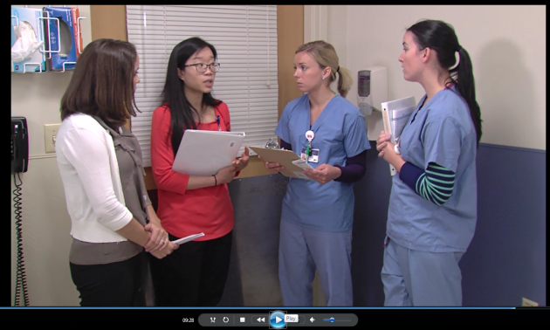
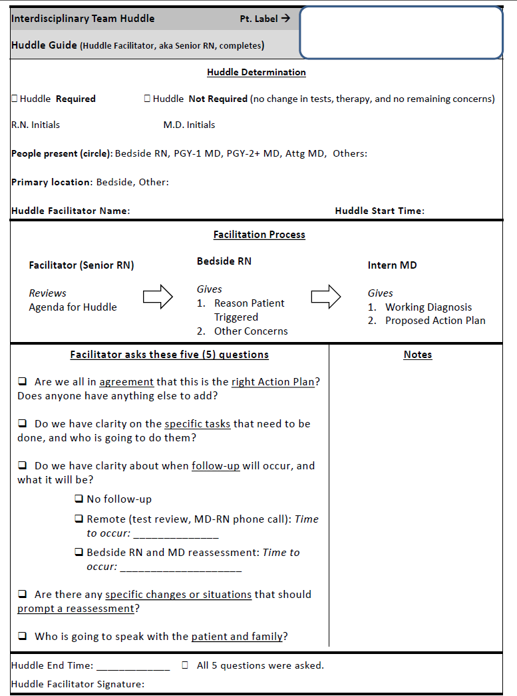
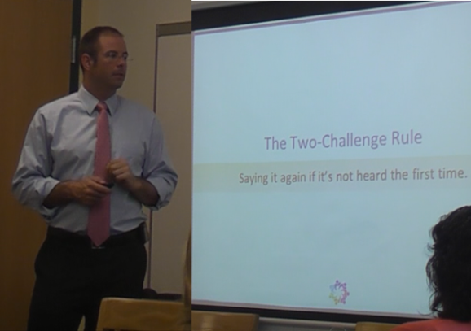
Our Intervention
  Build a project team
    Some team time funded by MA Healthcare Workforce Transformation Fund
  Train team members
  3-hour interdisciplinary team training sessions
  30-minute huddle facilitator trainings
  Brief structured huddle – “Triggers 2.0”
  Facilitator leads using a guide
  Case discussion, space for questions
  Delineate specific tasks and a follow-up plan
  Describe conditions that should prompt reassessment
  Ensure communication with the patient and family
This training has taught me . . .
The importance of open communication and teamwork that needs to be combined for and with patient advocacy and patient safety.
From today, I will apply . . .
A new confidence in speaking up as a member of the patient’s team. New terms or thought “models” of how to go about expressing concern.
I would still like . . .
To have more team-building to focus on huddle and personal experiences. The better we know each other the more effectively and efficiently we work together.
advocacy
safety
communication
A

Slide 4
Results
  Triggers 2.0 sustains and spreads
    254 triggers to date
    54% with a huddle
    64% of huddles included all team members
    Median huddle duration 4.4 minutes
    Expanding to new care areas at the request of providers
  Feedback
    “In my 20 years here, this is the best quality improvement project we’ve ever done.”
    “We had a surgery team here, and I just went in and conducted the huddle without telling them. To them, it was just natural.”
D

Slide 5
Results
Outcomes | When we DID Huddle n= 138 (54%) | When we DID NOT Huddle n= 116 (46%) | Fisher’s exact test, two-tailed
Transferred to ICU within 48 hours | 31 (22.5%) | 20 (17.2%) | P = 0.3468
Code Blue within 48 hours | 1 (0.7%) | 4 (3.4%) | P = 0.1814
Expired within 48 hours | 0 | 4 (3.4%) | P = 0.0423
Reflections
1. Association, not causation
2. What factors are associated with both not huddling and increased risk of death?
E.g. Staffing matching workload (night time, elevated floor acuity)?
E.g. Decreased recognition of risk (occult or subtle diseases, inexperience)?
D

Slide 6

Patient Engagement
  Stories from the Bedside . . .
  69% of the time, Huddles occur at the bedside
T

Slide 7
Lessons Learned
  Key factors to sustainability and spread
    Skilled huddle facilitation
      Huddles led by senior RNs with a vested interest in project success
      Most important training for implementation success
    Executive leadership support
  Measurement followed by troubleshooting, coaching
  Challenges
    Logistics of interdisciplinary trainings
    Showing improvements in clinical outcomes
  Questions? abrancha@bidmc.harvard.edu
T

